Slide 1
Linear Regression: Introduction to summary statistics

Slide 2
Output from statsmodels
Notes:
Note, this table is similar for many kinds of Statsmodels models, not just OLS

Slide 3
Target or dependent
variable

Slide 4
Model type: Ordinary
Least Squares = linear regression
Notes:
Method refers to cost function

Slide 5
m
Notes:
m is commonly used in matrix notation
n for number of features

Slide 6
Residual degrees of freedom
=
Number of observations - number of parameters (including intercept)
Notes:
what does the term, “degrees of freedom” mean? It refers to the number of (logically) independent pieces of information in a sample of data. Note that this is quite different from the ides of statistical independence.
Has to do with the rank of the transformation matrix from e (residuals) ; trace = n-k
https://davegiles.blogspot.com/2012/10/degrees-of-freedom-in-regression.html

Slide 7
Model degrees of freedom
=
Number of parameters – 1
(or # of features not including intercept)
Notes:
what does the term, “degrees of freedom” mean? It refers to the number of (logically) independent pieces of information in a sample of data. Note that this is quite different from the ides of statistical independence.
Has to do with the rank of the transformation matrix from e (residuals) ; trace = n-k
https://davegiles.blogspot.com/2012/10/degrees-of-freedom-in-regression.html

Slide 8

R²
Notes:
Definition: Proportion of variance in y that is explained by the model

Slide 9
Some thoughts about R²
OLS’s most controversial metric

Slide 10
Revisiting the OLS cost function
The OLS cost function minimizes the sum of squared residuals, also called the sum of squared errors (SSE)
We can also calculate the variance of the observed (actual) points, also called the total sum of squares (SST)

Slide 11
Calculating the R² metric
Notes:
INSTRUCTOR: Possibly introduce three types of error:
Bias
Variance
Irreducible error
Also R^2 is only positive if the model is better than the naïve “mean only” model

Slide 12
Calculating the R² metric
Source: Wikipedia page for R²
Notes:
INSTRUCTOR: Possibly introduce three types of error:
Bias
Variance
Irreducible error
Also R^2 is only positive if the model is better than the naïve “mean only” model

Slide 13
“Distraction or nuisance?” – CMU stats prof on R²
There are some reasons we teach R² and reasons why it’s popular
Easy to calculate and built-in to most stats packages
Does give us insight into how our model is behaving, given some strong conditions
Know that it doesn’t measure “how well the model fits”
Use it to compare only models with the same number of features
But there’s been pushback against R² in the stats and science community
E.g. This CMU stats professor’s notes that went viral (as much as such a thing can): http://www.stat.cmu.edu/~cshalizi/mreg/15/lectures/10/lecture-10.pdf

Slide 14
Debunking myths about R² (from Prof Shalizi’s lecture notes)
1) R² does not measure goodness of fit
It can be arbitrarily close to 1 for a wrong model and arbitrarily low for a correct model
Notes:
By making Var [X] small, or σ^2 large, we drive R2 towards 0, even when every assumption of the simple linear regression model is correct in every particular.
When model wrong: There is, indeed, no limit to how high R2 can get when the true model is nonlinear. All that’s needed is for the slope of the best linear approximation to be non-zero, and for Var [X] to get big

Slide 15
Debunking myths about R² (from Prof Shalizi’s lecture notes)
1) R² does not measure goodness of fit
It can be arbitrarily close to 1 for a wrong model and arbitrarily low for a correct model
2) R² is also pretty useless as a measure of predictability
R² says nothing about prediction error
Notes:
the ideal case: even with σ 2 exactly the same, and no change in the coefficients, R2 can be anywhere between 0 and 1 just by changing the range of X. Mean squared error is a much better measure of how good predictions are; better yet are estimates of out-of-sample error

Slide 16
Debunking myths about R² (from Prof Shalizi’s lecture notes)
1) R² does not measure goodness of fit
It can be arbitrarily close to 1 for a wrong model and arbitrarily low for a correct model
2) R² is also pretty useless as a measure of predictability
R² says nothing about prediction error
3) R² cannot be compared across data sets

Slide 17
Debunking myths about R² (from Prof Shalizi’s lecture notes)
1) R² does not measure goodness of fit
It can be arbitrarily close to 1 for a wrong model and arbitrarily low for a correct model
2) R² is also pretty useless as a measure of predictability
R² says nothing about prediction error
3) R² cannot be compared across data sets
4) R² cannot be compared between a model with untransformed Y and one with transformed Y , or between different transformations of Y

Slide 18
Debunking myths about R² (from Prof Shalizi’s lecture notes)
1) R² does not measure goodness of fit
It can be arbitrarily close to 1 for a wrong model and arbitrarily low for a correct model
2) R² is also pretty useless as a measure of predictability
R² says nothing about prediction error
3) R² cannot be compared across data sets
4) R² cannot be compared between a model with untransformed Y and one with transformed Y , or between different transformations of Y
5) The one situation where R² can be compared is when different models are fit to the same data set with the same, untransformed response variable

Slide 19
Debunking myths about R² (from Prof Shalizi’s lecture notes)
1) R² does not measure goodness of fit
It can be arbitrarily close to 1 for a wrong model and arbitrarily low for a correct model
2) R² is also pretty useless as a measure of predictability
R² says nothing about prediction error
3) R² cannot be compared across data sets
4) R² cannot be compared between a model with untransformed Y and one with transformed Y , or between different transformations of Y
5) The one situation where R² can be compared is when different models are fit to the same data set with the same, untransformed response variable
6) It is very common to say that R² is “the fraction of variance explained” by the regression
But if we regressed X on Y , we’d get exactly the same R² . This in itself should be enough to show that a high R² says nothing about explaining one variable by another

Slide 20
Adjusted R² can overcome some of the issues
m – k – 1
m – 1
m= # points
k = # parameters

Slide 21
Adjusted R² can overcome some of the issues
m – k – 1
m – 1
m= # points
k = # parameters
Use them with care…

Slide 22
More metrics

Slide 23
F-test
Null hypothesis:
This data can be modeled by setting all β values to zero
(the linear relationship we’ve found is purely due to chance)
Notes:
If there’s a very small probability that randomness caused us to get our coefficients, we reject the null

Slide 24
F-test
Prob (F-statistic):
The p-value for the whole model (i.e. probability of finding the observed-or more-extreme results when the null hypothesis (H₀) is true). If p-value <0.05, we can reject the null hypothesis (data is too extreme to fit this model just by chance). It doesn’t guarantee the model is “true”!
Notes:
As humans, stats help us but we have to decide if the model/relationship is validated.

Slide 25
Log
likelihood
Likelihood is another cost function!
For a given model with specific coefficients (assume the model is right), likelihood is the chance of seeing this real data. The model with maximum likelihood is the best fit!
Notes:
This is a probability trick where we can start from an assumption and calculate the chance of seeing the facts we see, then apply the logic backward. The model with highest likelihood will be the one that drops a line in the most likely areas of seeing data. Remember, we assume target is normally distributed.

Slide 26
t-test
Notes:
Like z-score but more conservative, for samples

Slide 27
t-test
Null hypothesis:
This specific β value is zero (the data can be created by such a model, with the other β values intact)
P >|t|:
P-value for this test. If p-value < 0.05, we can reject the null hypothesis:
This variable does contribute to this model (DOES or DOESN’T, not how much).
Notes:
When doing feature selection with p-values, we pick a threshold and think binary.
Note that Beta_0 can often be called “intercept” or “bias”.

Slide 28
Normality test
Null hypothesis:
ε is normally distributed, no skew, no excess kurtosis
Prob(Omnibus):
The p-value for this test. If p-value < 0.05, we reject the null hypothesis:
ε does not exactly follow the normal distribution that we assumed.
Notes:
Omnibus takes into account both Skew and Kurtosis below, so we look to find Prob above a certain threshold.
If our value was 15%, we could accept the null that residuals are normally distributed!
It’s rare Omnibus tells us what we want, but OLS can still be a good approach without it.

Slide 29
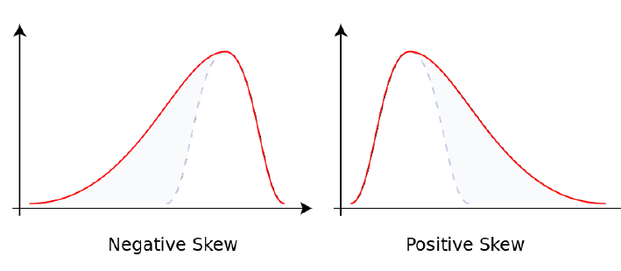
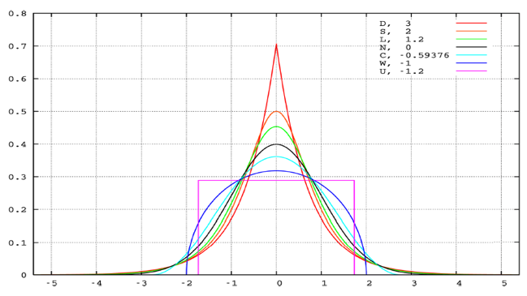
Skew &
Kurtosis
Skew
(asymmetry)
Kurtosis
(peakiness)

Slide 30
Another normality test
Null hypothesis:
Again, ε is normally distributed. We are looking for skewness ~ 0, and kurtosis ~ 3. JB is an alternate to Omnibus and tests if those conditions are close enough to ideal to accept the Null.
Prob(JB):
The p-value for this test.
Notes:
Omnibus and JB usually agree, but are calculated slightly differently

Slide 31
An autocorrelation test
Null hypothesis: Errors are uncorrelated
The Durbin Watson test reports a test statistic, with a value from 0 to 4, where:
2 is no autocorrelation.
0 to <2 is positive autocorrelation (common in time series data).
>2 to 4 is negative autocorrelation (less common in time series data).
Notes:
http://www.statisticshowto.com/durbin-watson-test-coefficient/

Slide 32
Sensitivity of prediction to small errors in input
Condition Number:
Given Mx=b, we can calculate the condition number :
CN = |λmax(M)|
|λmin(M)|
Note: if the condition number is large, the data matrix is ill-posed (does not have a unique, well-defined solution). This means the solution is unstable and coefficients can easily change with new data.
Notes:
condition number of a function measures how much the output value of the function can change for a small change in the input argument.
What is large? Depends on data but anything above 1e6 might be cause for concern.
Why unstable?: May be due to multi-collinear relationships between independent variables.

Slide 33
Introduction to model selection

Slide 34
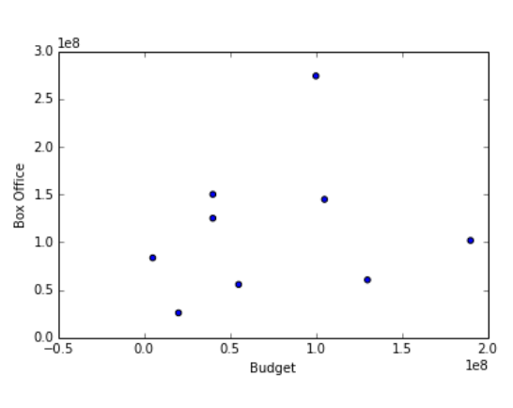
For models with the same number of features, easy:
Pick the model with the best cost function (highest log-likelihood)

Slide 35
Need to revisit over/under-fitting and model complexity
Under-fitting
Just Right
Overfitting
Notes:
Also called Bias/Variance tradeoff in ML
First and third will do poorly in the test set

Slide 36
Need to revisit over/under-fitting and model complexity
Process: Fit a training set then calculate MSE on your test set (in sklearn: fit > predict > score)
Notes:
Also called Bias/Variance tradeoff in ML
First and third will do poorly in the test set

Slide 37
We can use adjusted R2 for models of different complexity
Low adj. R²
Higher adj. R²
Highest adj. R²
Notes:
On the training set, which doesn’t matter in the end!

Slide 38
Akaike Information Criterion

Slide 39
AIC measures model parsimony (lower AIC is better)
k = # parameters
L = Log likelihood
Notes:
Lower indicates a more parsimonious model, relative to a model fit with a higher AIC.
It is a relative measure of model parsimony, so it only has meaning if we compare the AIC for alternate hypotheses (= different models of the data).
We can compare non-nested models. For instance, we could compare a linear to a non-linear model.
The comparisons are only valid for models that are fit to the same response data (ie values of y).
Degree 1 and 15 = High
Degree 4 = Low
https://www.r-bloggers.com/how-do-i-interpret-the-aic/

Slide 40
Bayesian Information Criterion

Slide 41
BIC is a penalized AIC, again lower is better
# parameters
# points
Log likelihood
Notes:
Have students guess which models have high vs. low BIC:
Degree 1 and 15 = High
Degree 4 = Low
BIC is just more sophisticated AIC that penalizes models which need more observations to learn

Slide 42
My model isn’t awesome enough yet!
What more can I do?

Slide 43
Try these and check test error
(or AIC ,BIC, etc.):
Use a smaller set of features
Try adding polynomials
Check functional forms for each feature
Try including other features
Use more data (bigger training set)
Regularization (this week)
Try other model types (future lectures)
Notes:
3. Take log or root, or another adjustment like box-cox?

